Slide 1
2.3.1 Scalar multiplication

Slide 2
Introduction
In this topic, we will
Describe the operation of scalar multiplication
First look at real scalar multiplication
Next look at complex scalar multiplication
Discuss some properties

Slide 3
Real scalar multiplication
Given a vector in R^{n}, we can multiply every entry in this vector by a real scalar α
This is usually written as αv but vα may occasionally be seen
For example, if , then

Slide 4
Real scalar multiplication
We may also just write

Slide 5
Real scalar multiplication
Note that,
Also, if , then

Slide 6
Geometric interpretation
Scalar multiplication by a real number does not change the direction of the vector
It stretches, shrinks or reflects the point through the origin

Slide 7
Complex scalar multiplication
Given a vector in C^{n}, we can multiply every entry in this vector by a complex scalar α
For example, if ,
then

Slide 8
Complex scalar multiplication
Note that if , then it is still true that
and
Multiplying v by –1 simply negates the entries,
just like with real vectors

Slide 9
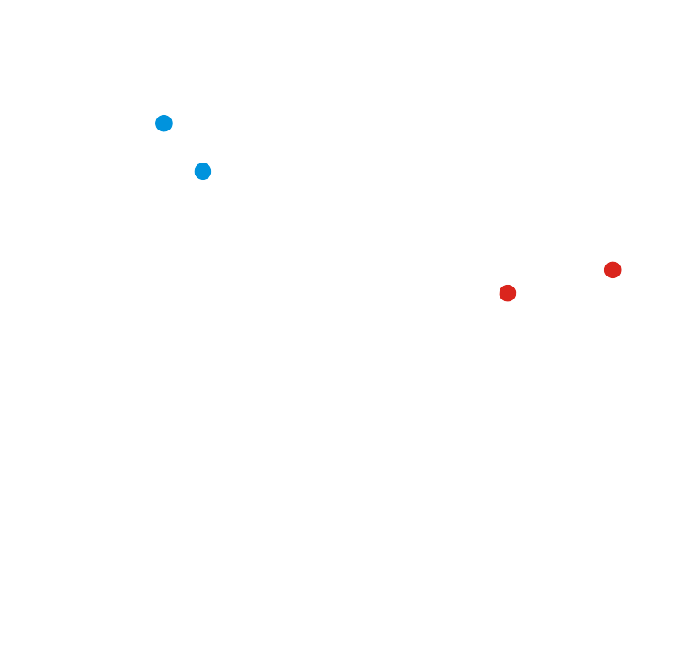
Terminology
If α >1, we may occasionally say α v amplifies the vector v

Slide 10
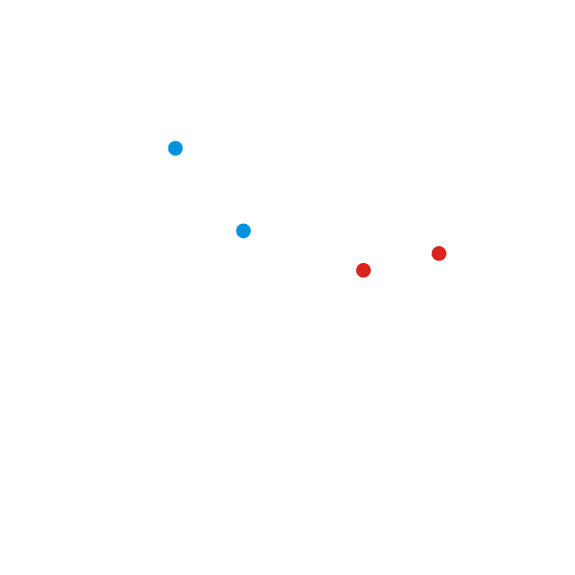
Terminology
Similarly, if 0 < α < 1,
we may occasionally say α v attenuates the vector v
Engineers tend to want to amplify signals of importance,
while attenuating noise

Slide 11
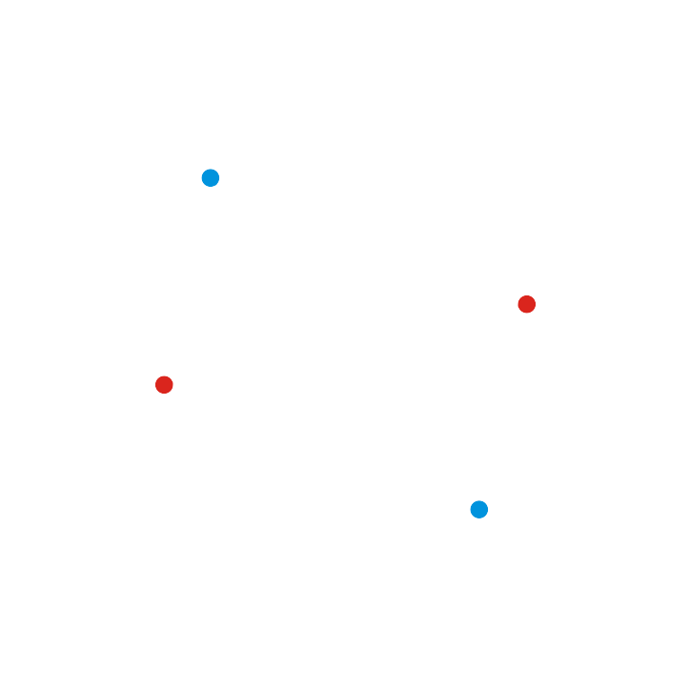
Terminology
Occasionally, if α = –1,
we may say –1·v mirrors v through the origin
Do not memorize these terms,
I will reiterate the definitions if I use them.

Slide 12
Observations
Note that:
Multiplying an n-dimensional vector by a scalar results in an n-dimensional vector
We are either dealing with real vectors or complex vectors
There is no point in asking “What happens if you multiply a real vector by a complex scalar?”
It’s like asking “What happens if you divide five cups of water between 1 + j people?”

Slide 13
Summary
Following this topic, you now
Understand the concept of scalar multiplication
Have seen examples for both real and complex numbers
Have been exposed to the terms amplify and attenuate
Looked at some properties and made some observations

Slide 14
References
[1] https://en.wikipedia.org/wiki/Scalar_multiplication

Slide 15
Acknowledgments
None so far.

Slide 16
Colophon
These slides were prepared using the Cambria typeface. Mathematical equations use Times New Roman, and source code is presented using Consolas.
The photographs of flowers and a monarch butter appearing on the title slide and accenting the top of each other slide were taken at the Royal Botanical Gardens in October of 2017 by Douglas Wilhelm Harder. Please see
https://www.rbg.ca/
for more information.

Slide 17
Disclaimer
These slides are provided for the ne 112 Linear algebra for nanotechnology engineering course taught at the University of Waterloo. The material in it reflects the authors’ best judgment in light of the information available to them at the time of preparation. Any reliance on these course slides by any party for any other purpose are the responsibility of such parties. The authors accept no responsibility for damages, if any, suffered by any party as a result of decisions made or actions based on these course slides for any other purpose than that for which it was intended.

